Slide 1
Welcome
please!

Slide 2

What is ?
Document centric environment.
Symbolic mathematics, numeric analysis, graphics and animation all seamlessly integrated.
Full programming language - expandable.
Feature rich, right out of the box:
6 automatic code generators;
Over 170 packages;
Connectivity to many other applications (including Intranet);
Thousands of functions, mathematical dictionary, tutorials, help, Assistants, Tutors, …
Toolboxes for further expansion

Slide 3
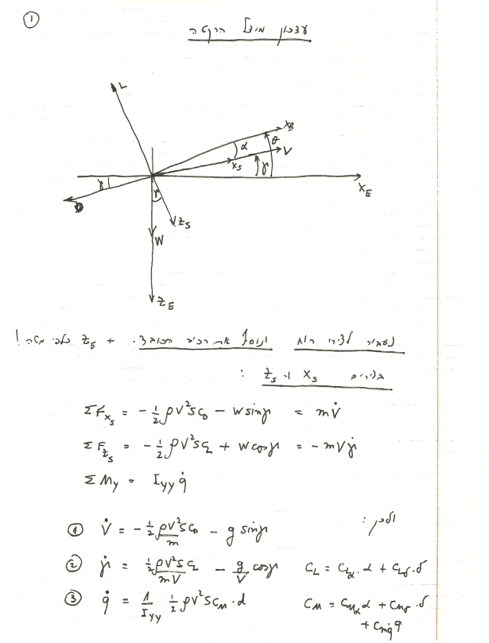
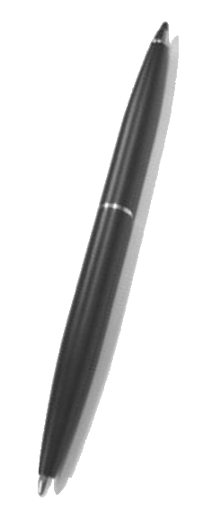
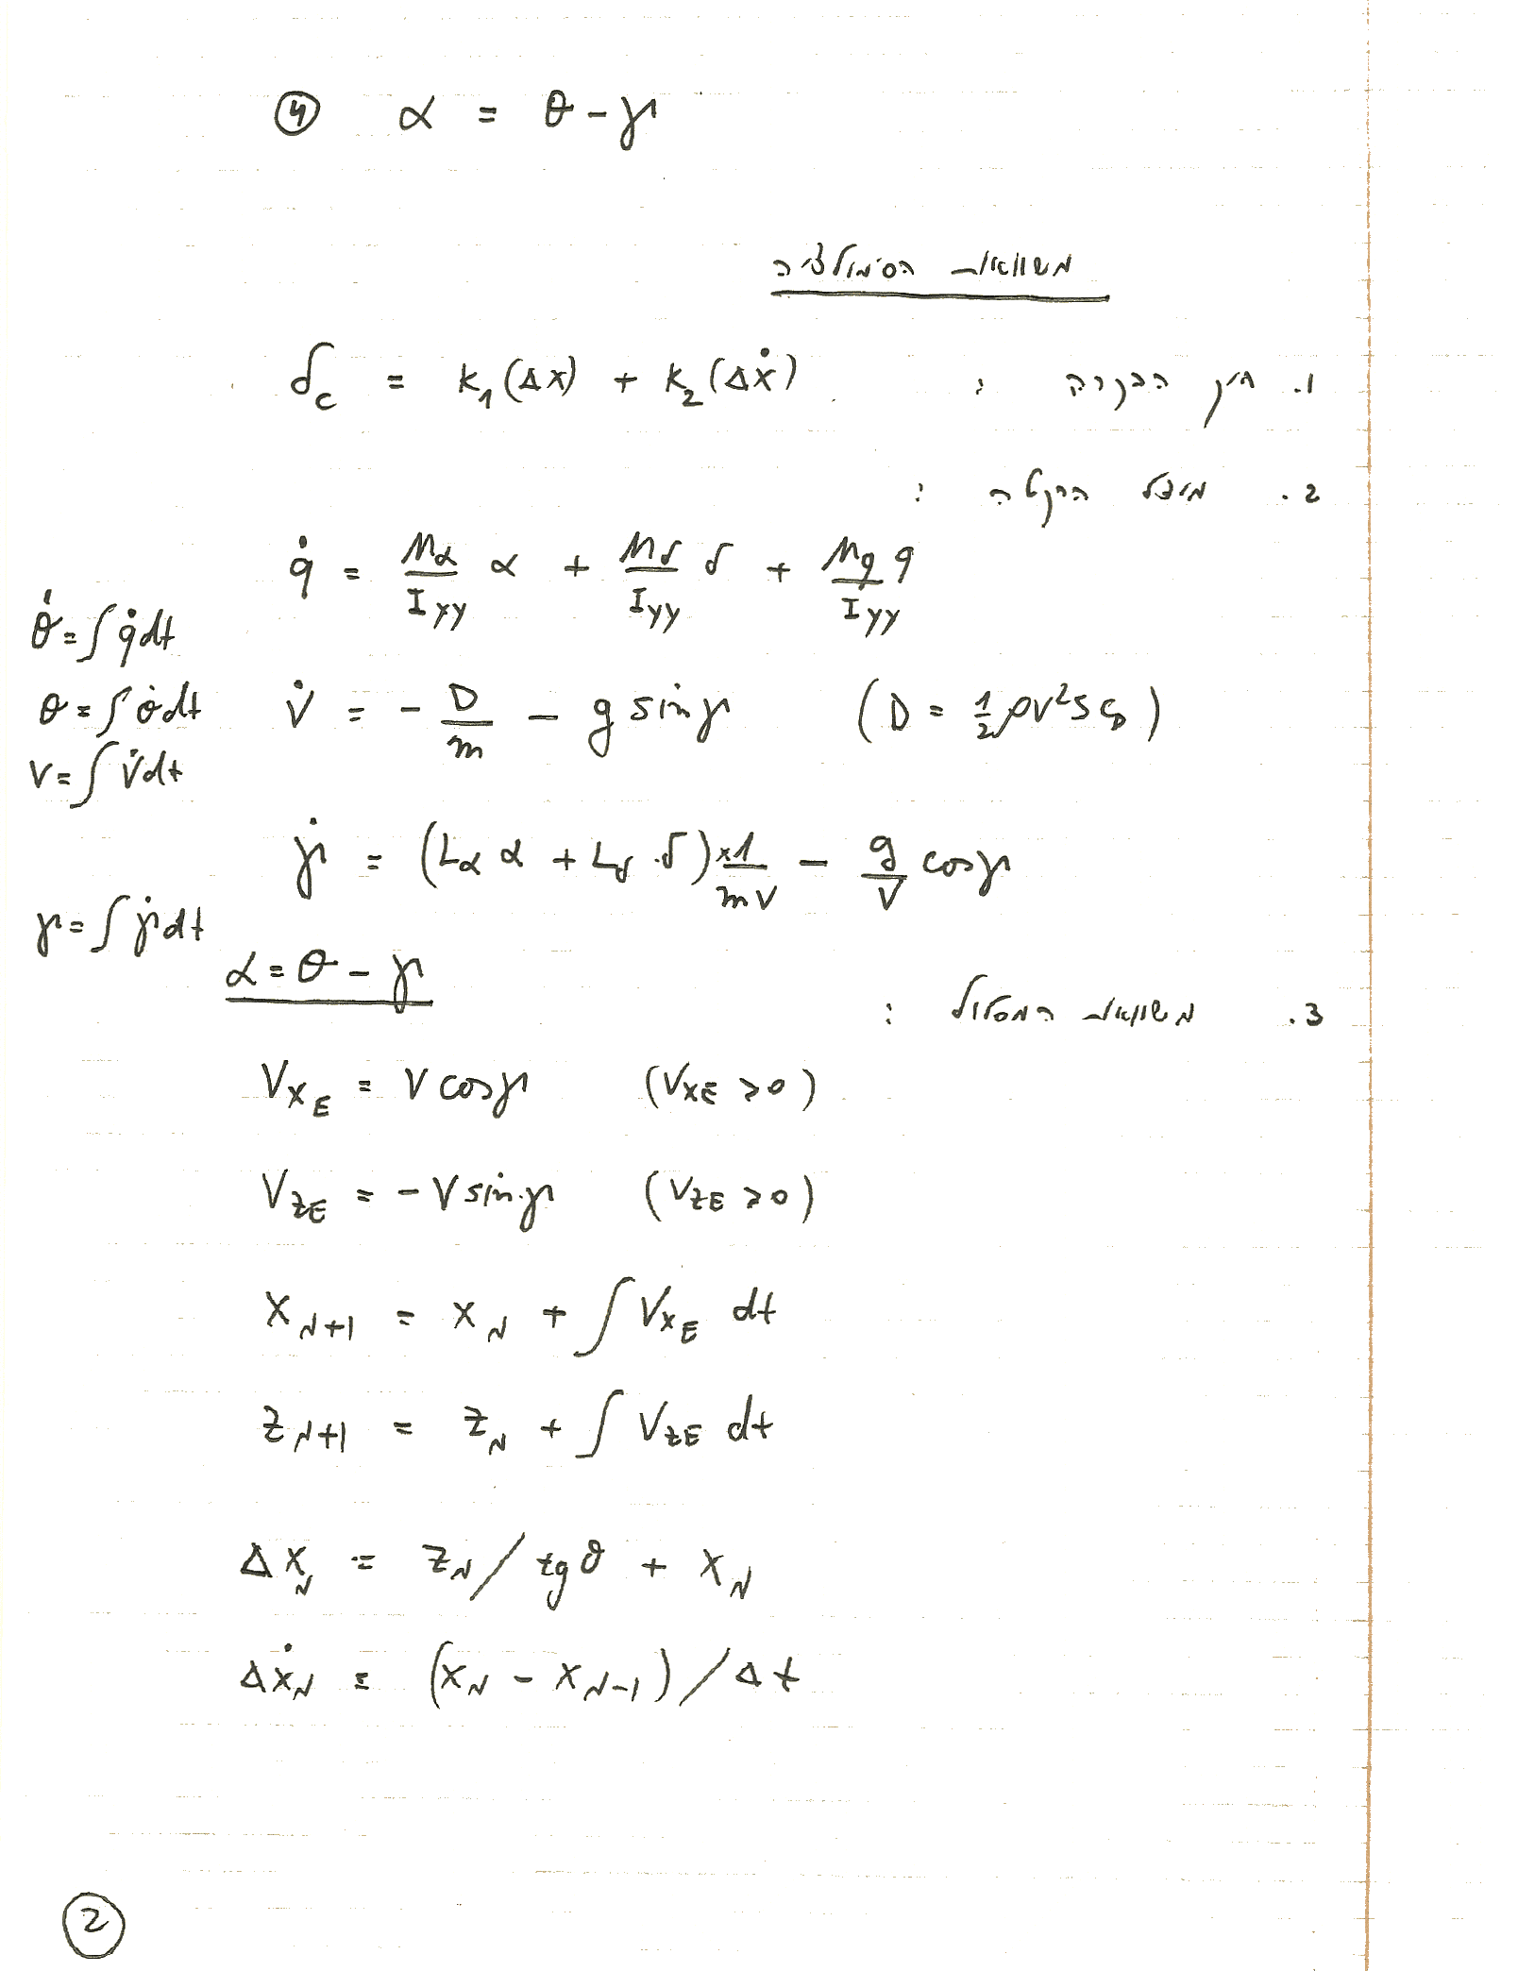
Before

Slide 4
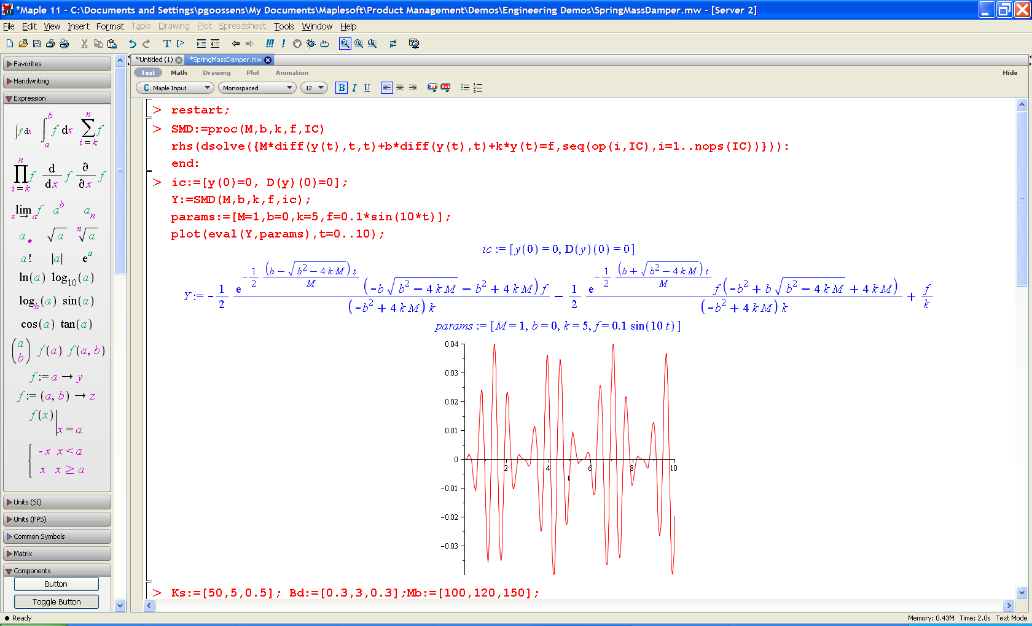
Before 10

Slide 5
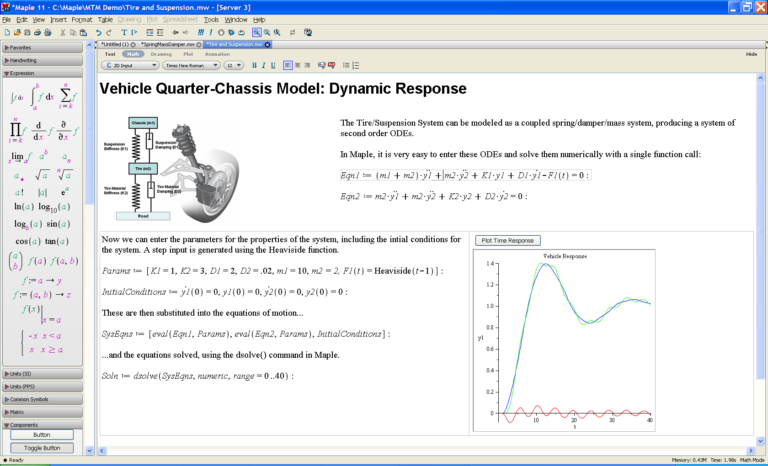
Document Interface

Slide 6







Toolchain
Tire Library
Driveline Component Library
Connector (Simulink)
LabVIEW & Veristand NI Conn.
MFI Connector (Modelica)
…
3rd party Toolboxes
Community Freeware
Online Testing and Assessment…Powered by MapleTM
Internet publishing of Maple worksheets
Physical Modelling
, the basic product and the engine

Slide 7

Why ?
Key Features

Slide 8
Increased Productivity
A 10,000 hours modeling and simulation project by the research department of a major automotive manufacturer has been re-produced in merely 45 minutes !!!
Major Time Saving

Slide 9
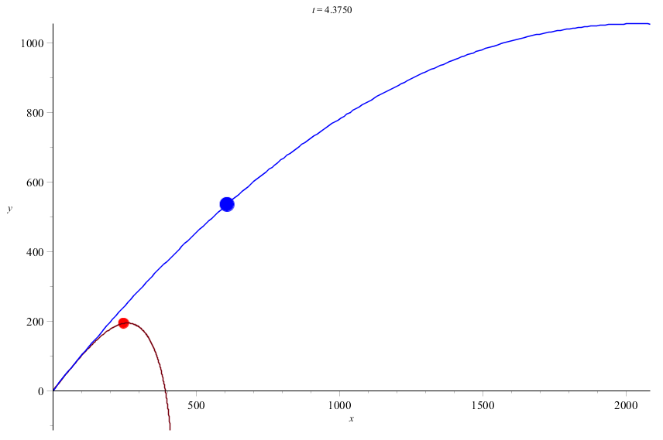

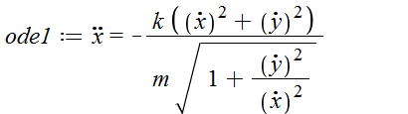
Increased Productivity
Major Time Saving
Better Understanding
Smart documents embedding natural clear mathematical notations, text and graphics explanations rather than cryptic programmatic code.

Slide 10
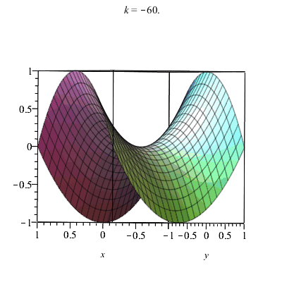
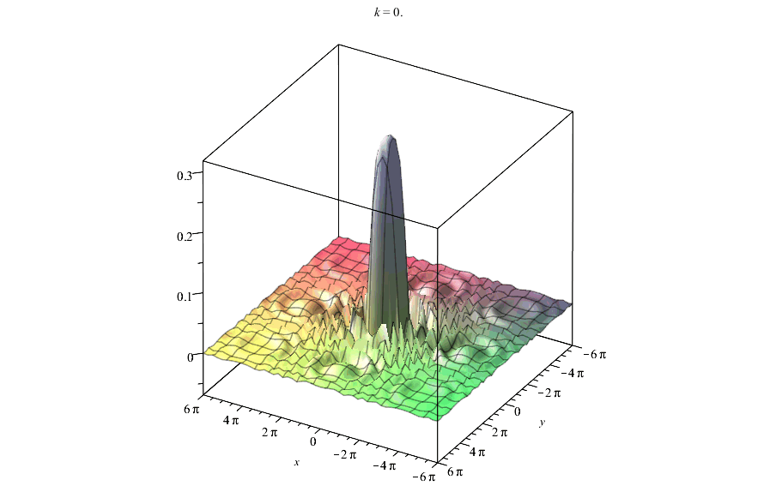
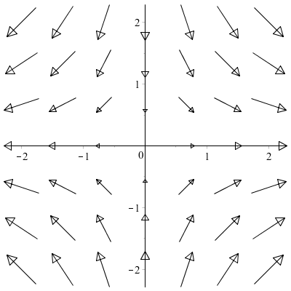
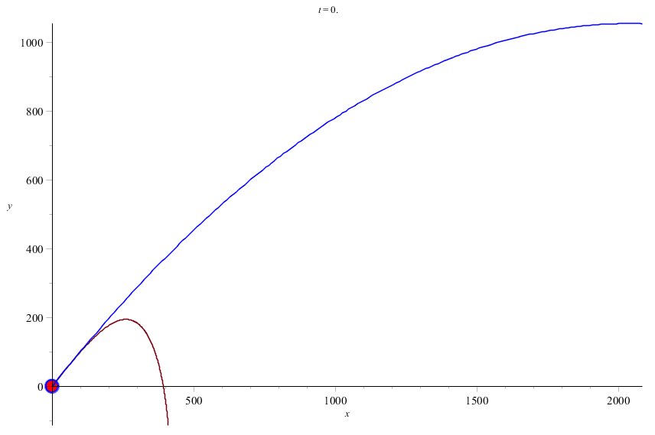
Increased Productivity
Major Time Saving
Better Understanding
Visualisation and Animation
Over 160 types of plots and total control over every aspect of visualisation.

Slide 11
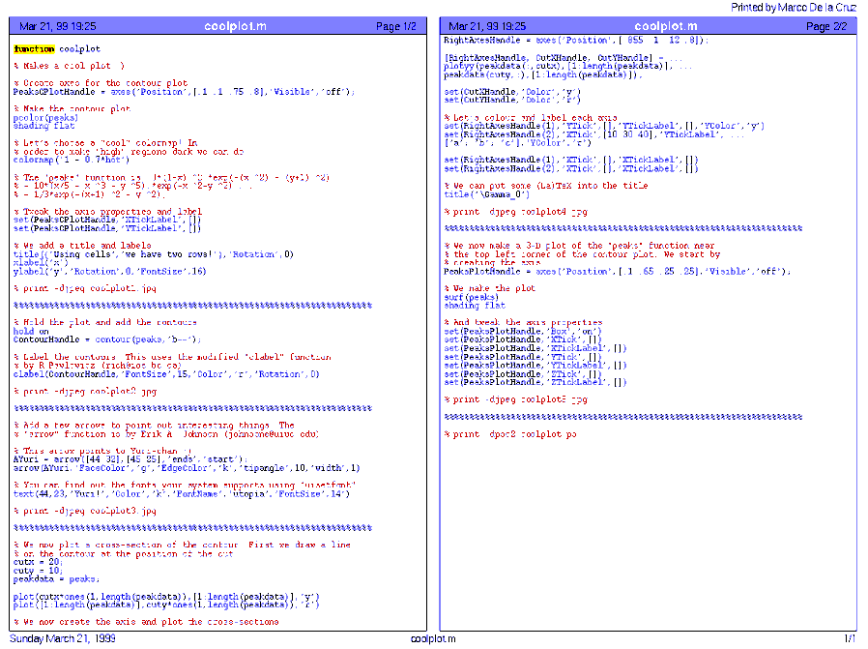
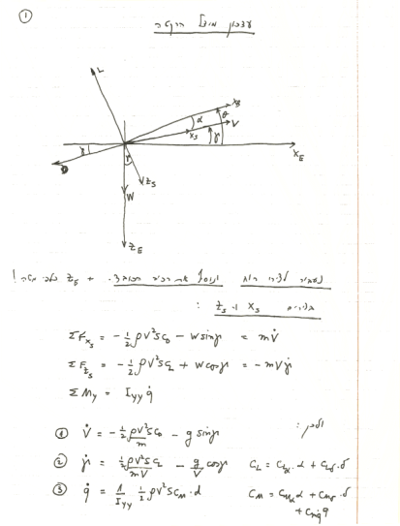
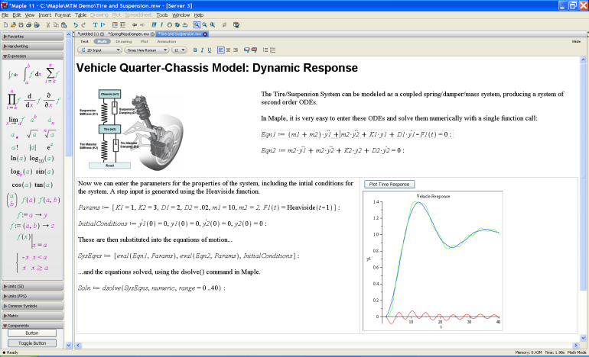
Increased Productivity
Major Time Saving
Better Understanding
Visualisation and Animation
Knowledge Capturing

Slide 12
Increased Productivity
Major Time Saving
Better Understanding
Visualisation and Animation
Knowledge Capturing
All in One
Symbolics, Numerics, Graphics, Programming.

Slide 13
Using …
Ease of Use

Slide 14
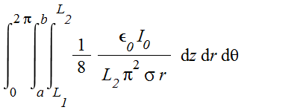

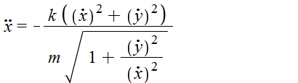

Ease of Use
2D Math
Natural mathematical notations, easy to write and to understand.

Slide 15
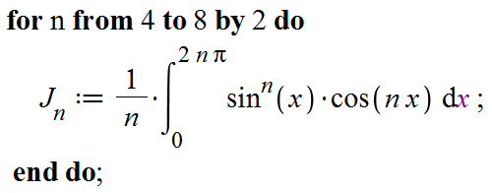
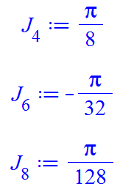
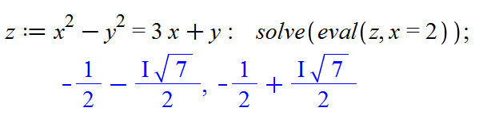
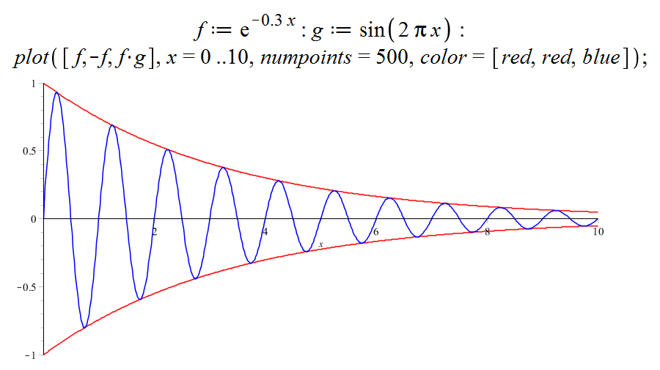
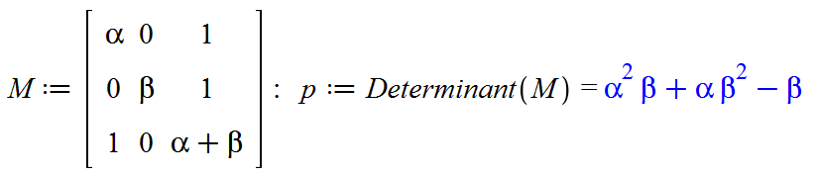
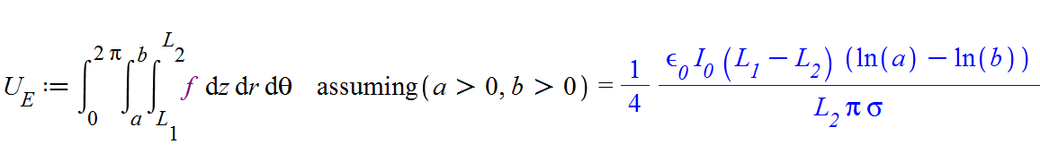
Ease of Use
2D Math
Intuitive

Slide 16
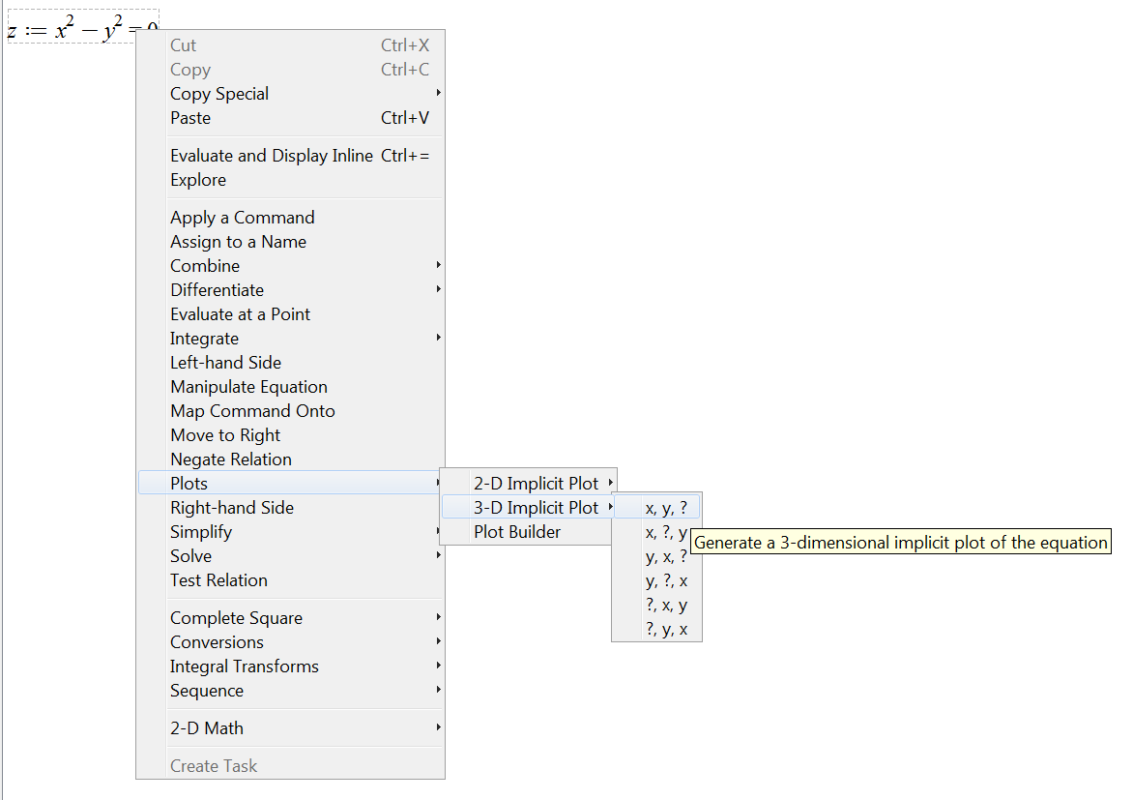
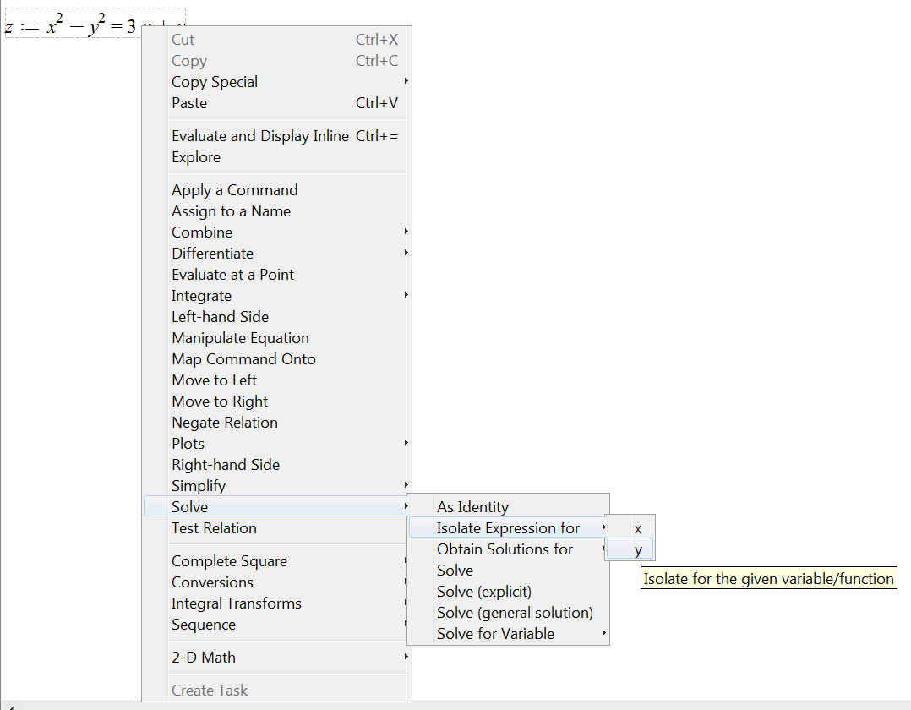
Ease of Use
2D Math
Intuitive
Clickable Operations

Slide 17
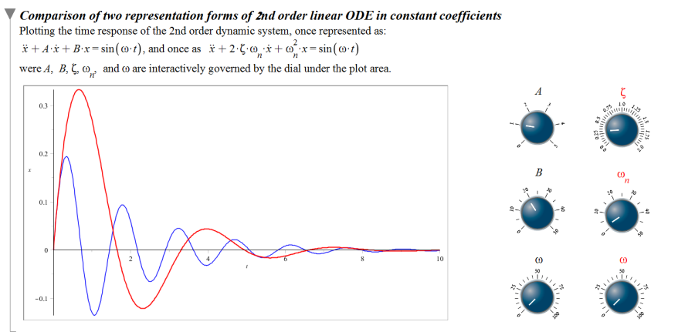
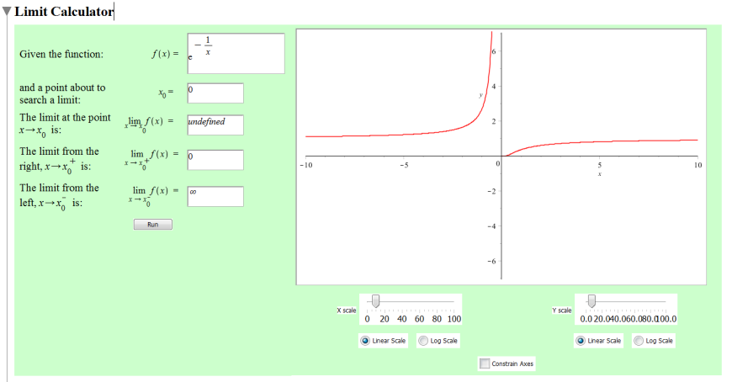
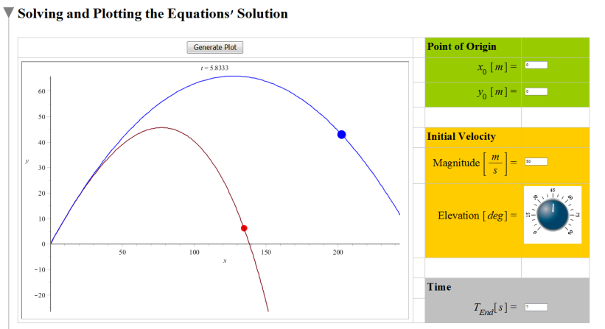
Ease of Use
2D Math
Intuitive
Clickable Operations
Active Controls

Slide 18
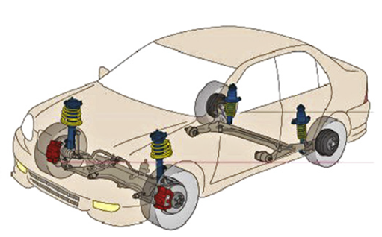
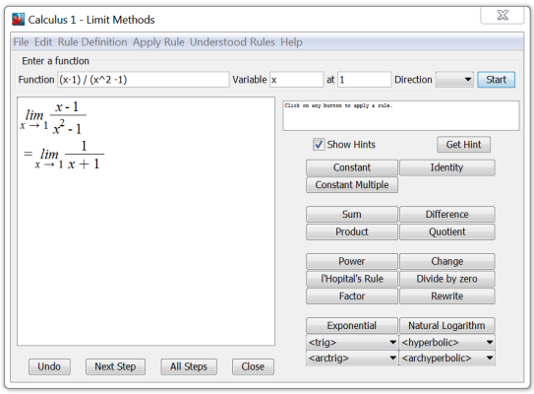
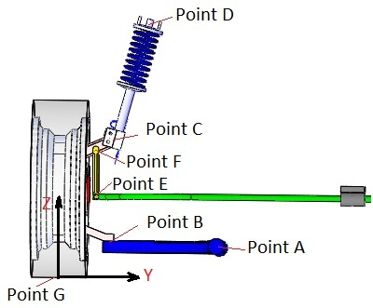
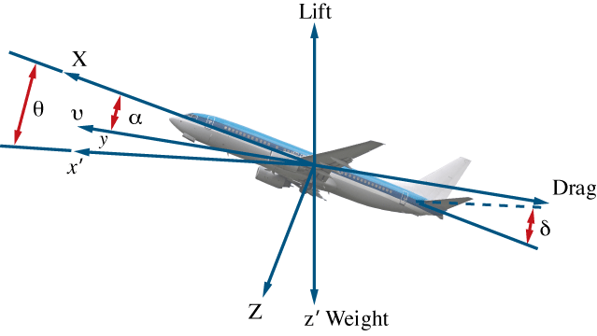
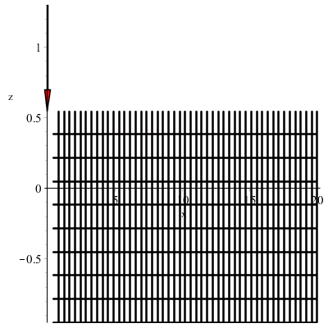
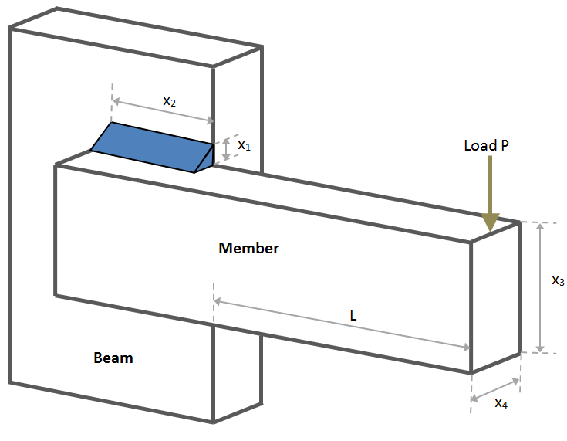
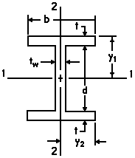
Ease of Use
2D Math
Intuitive
Clickable Operations
Active Controls
Thousands of Applications

Slide 19


Ease of Use
2D Math
Intuitive
Clickable Operations
Active Controls
Thousands of Applications
Community and Support

Slide 20
’s Availability and Distribution
Where and how to get it?
Who is using it?

Slide 21
Availability
IUCC Unlimited Licence
Every Technion’s computers room, classroom or office!
Every computer on campus / VPN
Student Kit Special (Israel only!)
₪50, 1 year term licence, Full software + Bonus pack!
Eligibility: Every student who has a student card or student certificate frim an Israeli institution
Includes: Maple, (the same package as the ₪19,995 pro licence)
eBooks Bonus pack: Math Survival Guide, Advanced Engineering Math

Slide 22





















Market Distribution

Slide 23
Legal Issues
is NOT a US company!
and its derived products are NOT subjected in any way to US exporting licence and policies!
Using DOES NOT require US EULA
(EULA = End User Licence Agreement)
Notes:
Math increases efficiency and productivity in vehicle dynamic modeling
Introduction {Draft}
Vehicle manufacturers are constantly faced with the challenge of balancing fuel efficiency and safety against the demands for greater performance. This, along with the constant need for reducing design costs, has led to the increasing replacement of traditional passive components by active mechatronic systems that comprise electro-mechanical components and electronic controllers.
Because of this, the demand for better understanding of the dynamics, particularly for controller development, has reached a critical point for many engineers, who are seeking analytical tools to help them.
This article will examine these challenges, particularly in the context of modeling and optimizing the design of vehicle dynamic behavior. The range of engineering modeling tools from Maplesoft offers solutions to many of the high-fidelity modeling problems facing vehicle dynamicists, particularly those who need to implement vehicle dynamics in real-time simulators for hardware-in-the-loop testing

Slide 24
Performance and Range of Application
Best symbolic math on the market. Period.
Best numeric algorithms on the market (NAG library) for enhanced performance.
Indefinite number precision
The only software compliant with IEEE 754 on all 64bit calculations (double precision)!
Up to 400 times faster than MATLAB (e.g. loops , adding symbolic matrices, …).
Multithreaded and made to utilise multi cores out of the box
6 automatic code generators out of the box! Real Time Run (C / C++, C#, Fortran, Java, MATLAB, Visual Basic )
Over 170 internal packages for all your needs ( no need to purchase a mountain of toolboxes for extra expense )
Multi-platform (Windows, Linux, Mac, UNIX)
Notes:
Math increases efficiency and productivity in vehicle dynamic modeling
Introduction {Draft}
Vehicle manufacturers are constantly faced with the challenge of balancing fuel efficiency and safety against the demands for greater performance. This, along with the constant need for reducing design costs, has led to the increasing replacement of traditional passive components by active mechatronic systems that comprise electro-mechanical components and electronic controllers.
Because of this, the demand for better understanding of the dynamics, particularly for controller development, has reached a critical point for many engineers, who are seeking analytical tools to help them.
This article will examine these challenges, particularly in the context of modeling and optimizing the design of vehicle dynamic behavior. The range of engineering modeling tools from Maplesoft offers solutions to many of the high-fidelity modeling problems facing vehicle dynamicists, particularly those who need to implement vehicle dynamics in real-time simulators for hardware-in-the-loop testing

Slide 25
Connectivity
LabView / VeriStand (Hardware in the loop)
MATLAB (MTM= Maple Toolbox for MATLAB, replacing the MATLAB Symbolic Toolbox)
Simulink (Connector & BlockImporter Toolbox)
Standard document, External application links (XML, RTF, LaTeX, HTML, MapleNET, Excel link)
External numeric libraries (LAPACK, ATLAS, NAG)
Modelica, B&R Automation studio, dSPACE, VI Car Real Time…
CAD (SolidWorks, UGS, …)
Notes:
Math increases efficiency and productivity in vehicle dynamic modeling
Introduction {Draft}
Vehicle manufacturers are constantly faced with the challenge of balancing fuel efficiency and safety against the demands for greater performance. This, along with the constant need for reducing design costs, has led to the increasing replacement of traditional passive components by active mechatronic systems that comprise electro-mechanical components and electronic controllers.
Because of this, the demand for better understanding of the dynamics, particularly for controller development, has reached a critical point for many engineers, who are seeking analytical tools to help them.
This article will examine these challenges, particularly in the context of modeling and optimizing the design of vehicle dynamic behavior. The range of engineering modeling tools from Maplesoft offers solutions to many of the high-fidelity modeling problems facing vehicle dynamicists, particularly those who need to implement vehicle dynamics in real-time simulators for hardware-in-the-loop testing

Slide 26

Further Expansion Toolboxes
Global Optimisation Toolbox
Fuzzy Sets
Quaternion Algebra
Financial Modelling Toolbox
eBooks
Control Design Toolbox
Connectivity Toolbox
LabVIEW / Veristand TB
Tire Modelling Library
Notes:
Math increases efficiency and productivity in vehicle dynamic modeling
Introduction {Draft}
Vehicle manufacturers are constantly faced with the challenge of balancing fuel efficiency and safety against the demands for greater performance. This, along with the constant need for reducing design costs, has led to the increasing replacement of traditional passive components by active mechatronic systems that comprise electro-mechanical components and electronic controllers.
Because of this, the demand for better understanding of the dynamics, particularly for controller development, has reached a critical point for many engineers, who are seeking analytical tools to help them.
This article will examine these challenges, particularly in the context of modeling and optimizing the design of vehicle dynamic behavior. The range of engineering modeling tools from Maplesoft offers solutions to many of the high-fidelity modeling problems facing vehicle dynamicists, particularly those who need to implement vehicle dynamics in real-time simulators for hardware-in-the-loop testing

Slide 27
Contact
Omer Yagel
VP Business Development and Instruction
DigiSec Technology LTD
omer@digisec-technology.com
054 – 4545 062
http://www.digisec-technology.com

Slide 28
Live Demonstration

