Slide 1

MapleSim and the Advantages of Physical Modeling
RAFAEL
April 22nd 2$\text{i}$013
please!
Notes:
I’ll be talking about the value our tools bring to the embedded controls design process. Although some parts of this presentation will be targeted to the automotive industry, many of the concepts can cross over into other disciplines and fields of study.
There’ll be two parts to my presentation. In the first half I’ll explore some of the unifying concepts Maplesoft have developed over the last twenty years, and most notably over the lsat few years with the refinement of our symbolic math technology, the introduction of tools like MapleSim, and our partnership with Toyota.

Slide 2
Please try to model this plant
V=220 V
R = 10 KΩ
L=100 Hn
J=5 Kg m^2
Open Simulink and try it…
In 30 min from now we will do it with MapleSim
R
L
V
~

Slide 3

The Evolution of Multi-Domain Modeling
General purpose
languages
e.g. FORTRAN
Specialized numerical
mathematics
e.g. NAG, MATLAB
State-based
simulation
e.g. Simulink
Acausal modeling
environments
e.g. MapleSim
Problem Analysis
Problem Analysis
Problem Analysis
Problem Analysis
Human effort
Intuition & physics
Intuition & physics
Intuition & physics
Intuition & physics
Model equations
Model equations
Model equations
Model equations
Simulation model
Simulation model
Simulation model
Simulation model
Numerical
algorithms
Numerical
algorithms
Numerical
algorithms
Numerical
algorithms
Computer effort
Execute numerical
algorithms
Execute numerical
algorithms
Execute numerical
algorithms
Execute numerical
algorithms
Numerical experts
Math experts
Modeling experts
Engineers
User
User
Math experts
Modeling experts
Engineers
User
User
Modeling experts
Engineers
User
User
Engineers
Notes:
3

Slide 4





Why is physical modeling so difficult?
Multidomain/multiphysics
Legacy of causal (signal-flow) modeling tools
Differential-algebraic equations (DAEs)
Fundamental principles in physics and mathematics
Notes:
Plant modeling is difficult. This is because engineers are expected to create more complex designs with fewer resources. The computer models needed to create these designs consume project time at an increasing rate, and this is due in no small part to the limitations of existing tools
Multidomain modeling is becoming an increasing important topic in physical modeling.
Something like mechatronics, for example, combines mechanical and electronic engineering.
*Hybrid engines combine mechanical, thermal, electric, and more.
Good domain-specific tools have been available for many years. However, combining components from different domains is often difficult. This is because you need to reconcile mathematical details of the many parameters and model variables, and these conventional tools, due to their original rigid view of a specific domain are extremely difficult to adapt to modern multidomain situations.
Additionally, causal or signal flow tools that have become very popular for modeling and simulation over the past twenty years. These tools are based on the design metaphor of the analogue computer, a paradigm that’s thirty, forty years old.
With these tools, you have to manually derive the underlying mathematical equations of the systems and then break down the equations into individual mathematical operations and implement them on the software as separate blocks. This is an extremely time consuming and error-prone process and is only feasible for single-domain systems of modest complexity. With higher fidelity multidomain models, the amount of effort increases exponentially.
Realistic physical models are large and are not maintainable or fast enough for the new generation of problems.
Another challenge is the triggering of mathematical equation forms that are significantly more complex than those that engineers have dealt with in the past. For example, in many cases, systems of coupled differential ALGEBRAIC equations (or DAEs) arise from the formulation of certain types of component configurations. These equations cannot be easily solved by the differential equation solvers that traditional software have been programmed to deal with and new approaches must be taken.
Overall, physical modeling is forcing engineers to work much more closely with a greater range of physics and mathematics principles than ever before. In most cases, these are concepts that were not needed with software tools designed to handle single-domain problems. Today, without the right tools, many engineers are faced with applying theoretical concepts that they have not seen since university or are concepts traditionally used only by the research community. One of the great challenges of effective physical modeling is to allow engineers to manage and deploy these fundamental concepts in practical and accurate ways.

Slide 5
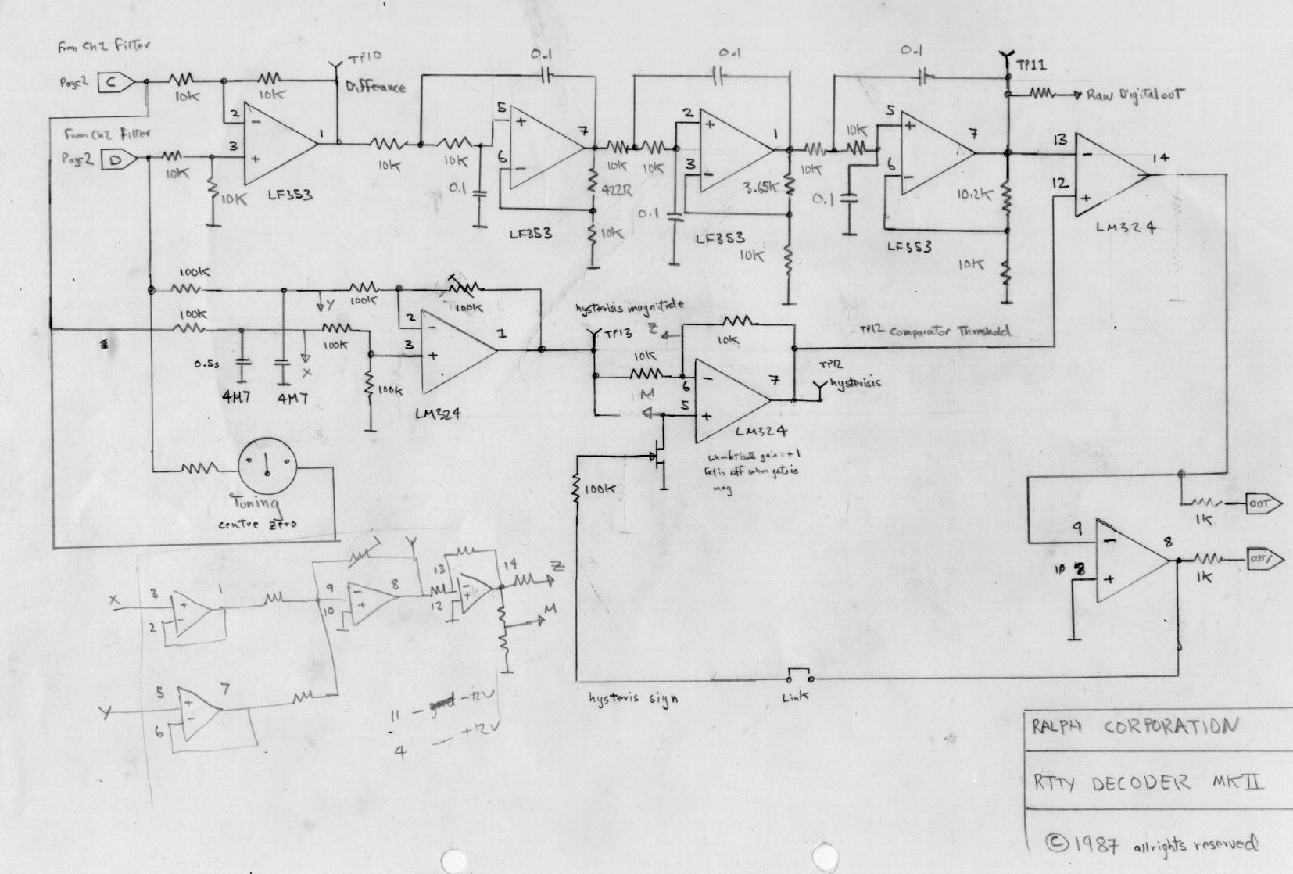
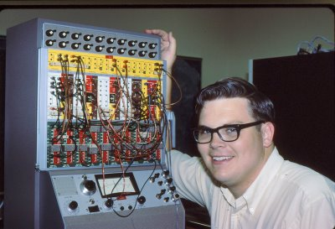
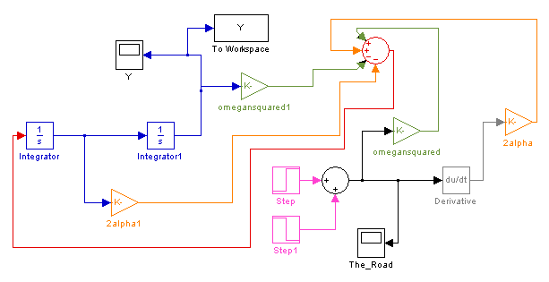
The Story of the Analog Computer
An analog
computer
“program”
Simulink is essentially
an analog computer running
on a PC …
A “virtual” analog computer
Notes:
Let’s take a step back and look at analog computers.
Anyone’s who’s perhaps twice as old as Maple remembers using analog computers. These are starkly different to the digital computers that we use today. Essentially to get an analogue computer to solve a problem you had to create a whole new circuit with various levers, dials and switches. They relied on the mathematical similarity between electrical components and physical components. For example, you could program a spring mass damper with a couple of operational amplifiers and a few passive linear components. You could use voltages to simulate water pressure and currents to simulate flowrate. You’d use an oscilloscope to view the results of a program.
Click
This is typically what a computer program in an analogue computer would look like – it’s just a circuit and there’s very little chance a sane person could reverse engineer the mathematics, let alone the physical system from something like this. Are you simulating a spring-mass damper or the draining of one tank into another. Their circuitry may look surprisingly similar. I suppose the natural conclusion of the abstract nature of simulink is that it’s very difficult for you, let alone anyone else to understand a simulink block diagram, making it difficult to make the development of simulink block diagrams a team effort.
For most people, the act of programming analogue computers died a welcome death a long time ago, but they still live on for engineers in the form of Simulink,
Click
This is what a simulink simulation look like. It’s a virtualization of an analogue computer, that’s all it is. The mathworks have made it easier to draw and run the circuit diagram, but you’re still using the same principles as an analogue computer. You even use scopes (“oscilloscpes”) to view the results of a simulation. I’d like to drive home how obtuse this kind of thing can be.
There are three primary challenges with using causal simulation tools to simulate physical systems.

Slide 6

Causal modeling: Challenges...
Complexity of equations does not scale linearly with the size of the system
  As complexity/size increases, so does the chance of errors
  Prevents high fidelity modeling of larger systems, particularly when applied to plant models
Example: 3D pendulum with increasing number of links:
# of Links | # of Additions | # of Multiplications | # of Acausal Blocks
1 | 2 | 7 | 5
2 | 21 | 82 | 9
3 | 135 | 660 | 13
4 | 669 | 3,974 | 17
5 | 2,726 | 19,224 | 21
* Cost of dynamic equations, joint coordinate formulation, basic symbolic simplify()
Notes:
Causal modeling tools are based on a design paradigm that’s well over fifty years old – the analog computer. Why are existing signal flow tools completely inadequate for physical modeling.
I think there are three primary reasons.
Mention the number of Causal blocks
Chance of errors – both in equation formulation and in block transfer

Slide 7
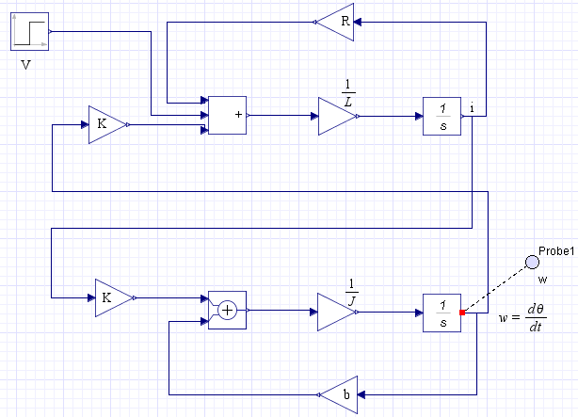
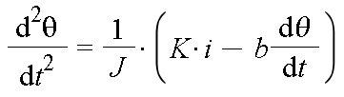
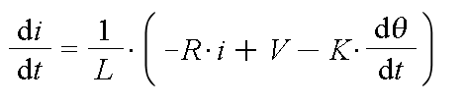
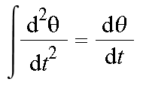

Causal modeling: Challenges...
Generated model looks nothing like the formulated equations or model diagram
  Assumptions made during equation formulation lost
  Hard to track errors
  Hard to visually understand the purpose of the system
R
L
~
?
V
?

Slide 8
Causal modeling: Challenges...
Since these models have predefined inputs/outputs, it is difficult to (properly) connect two causal models
  This becomes more important as the scope of models increases (i.e. connect powertrain model to chassis/tire model)
  In most cases this can require an equation re-formulation (to be done properly)
Inputs
Engine/
Powertrain
Angle
?
Torque
Chassis/Tire
Outputs

Slide 9
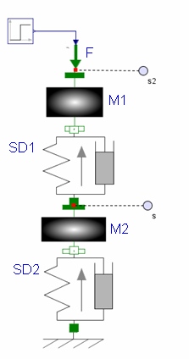
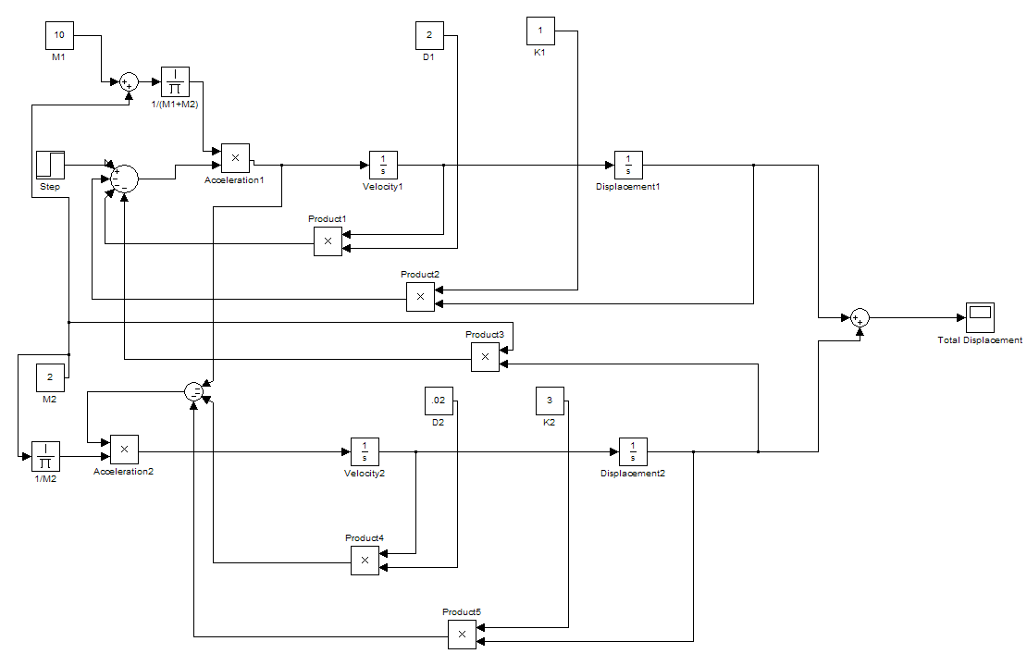
Physical Modelling – Faster & Intuitive
F(t)
x1(t)
M1
d1
k1
F(t)
x2(t)
M2
d2
k2
Model maps directly to physical components of system
Automatically generates equations of motion
Double mass
spring-damper system
Notes:
So what do I mean by physical modeling, and specifically physical modeling software
So, what do we mean by physical modeling, and why are companies like Toyota so interested in our approach to it? Let’s take a look at a simple example.
Here we have a typical representation of a dynamic system that we want to simulate.
{click}
With traditional tools, even a simple system like this is onerous to model.
First you have to manually derive the equations of motion then manipulate them into a form that can be entered into a block diagram representation.
Each of these steps is time-consuming, and the scope for error enormous.
Not only that, this representation looks nothing like the physical system.
{click}
What you really want to do is simply recreate the system diagram on the screen and the computer does the rest for you.
{click}
The model then maps directly to each physical component, and how they are connected together…
{click}
…and the equations of motion are automatically generated for you.
This can save hours, even days on complex applications.

Slide 10
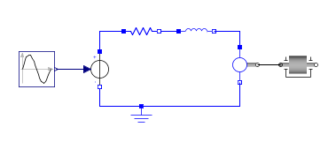
Physical Modelling – Faster & Intuitive
Basic steps for building an acausal model:
Use blocks or components to define the topology of your system
R
L
V
~
R
L
v(t)
J
Notes:
Acausal modelling really only makes sense in the context of making a plant model. However, in this context, it’s a very powerful tool.
Essentially, the process of creating an acausal model of a physical system simply consists of dragging the components that are in the system diagram into the modelling tool and connecting them to one another. That’s all that is required.
For example, an acausal model of a DC motor is shown on the lower right of the screen.

Slide 11
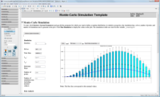
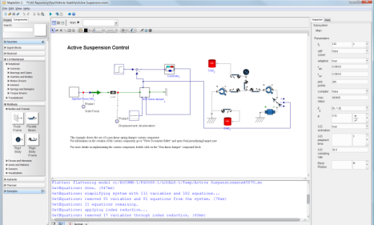

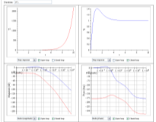
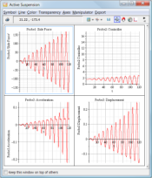
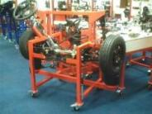
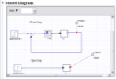
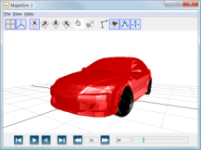
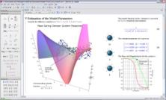
Maplesoft engineering solution
Control
Design
Toolbox
MapleSim 6.1
Connectivity
Toolboxes
Simulink RTW
Toolchain
LabVIEW RT
Toolchain
CAD
Toolchain
Maple 17
Maple Toolboxes
Notes:
The challenge for companies like Maplesoft is to [r
Foundation is Maple and its toolboxes. Provides all of the necessary core mathematical services for modeling and simulation. Additionally, it offers a rich documentation environment for capturing technical knowledge associated with models.
MapleSim is the primary modeling environment with an extensive range of physical modeling and signal-flow modeling components accessible through an efficient interactive environment. Unique features include full multidomain/multiphysics support, automatic generation of model equations, efficient management of parameters, 3D animation for multibody dynamics, and fully extendable range of advanced analysis tools.
In addition, there is a range of add-on tools designed to improve modeling and simulation. Most notable are:
Control systems toolbox that provide essential tools for control system design. For control applications, this toolbox extends MapleSim’s strength in plant modeling into basic controller design.
Connectivity toolboxes connect models and controllers developed in MapleSim to important toolchains. For example, you can develop high-fidelity physical models in MapleSim and then transfer the model easily to legacy toolchains such as Simulink, the best known among the traditional signal flow modeling tools.
One of the most common reasons for connecting these particular tools is for hardware in the loop HIL testing. Through optimized code generation, MapleSim models can be directly connected to the Simulink and Realtime Workshop toolchain. This results in HIL simulations that can be an order of magnitude faster than with other physical modeling tools. Similar connectivity can be enjoyed with the National Instruments LabVIEW toolchain. And both MapleSim and Maple offer connectivity to CAD systems for visualization applications or adding system level analysis to your CAD models.

Slide 12
Symbolic computation for plant modelling
MapleSim Symbolic Formulation
Standard Numeric Formulation
Model Definition
Model Definition
Coordinate Selection
Equation Generation
Symbolic Simplification
Numerical black box
Code Optimization
Simulation Procedure Generation with Limited Optimization
Simulation Procedure Generation with Limited Optimization
Simulation Procedure
Generation
Simulation
Simulation
Notes:
So what is it about MapleSim that makes it a good tool for control system and plant modeling. Well, it’s our underlying technology. Standard numerical tools allow you to create a model definition and then solve it numerically.; There may be some limited optimization involved.

Slide 13
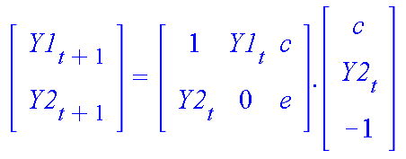
Standard Numeric Formulation
Generated procedure is a set of routines that multiply/add numerical matrices to reformulate the equations at each time step
-6 multiplications, 4 additions per step
Certain optimizations can be built into these routines but these are limited, and must be defined ahead of time
Model Definition
Numerical black box
Simulation Procedure Generation with Limited Optimization
Simulation
Notes:
Standard numerical tools generate sets of matrix equations that have to be generated and solved at each time step. There are certain optimizations that can be built in, but these are pretty limited in their scope.

Slide 14
Symbolic computation for plant modelling
MapleSim Symbolic Formulation
Standard Numeric Formulation
Model Definition
Model Definition
Coordinate Selection
Coordinate Selection
MapleSim applies 4 levels of model optimization
Equation Generation
Equation Generation
Symbolic Simplification
Symbolic Simplification
Numerical black box
Code Optimization
Code Optimization
Simulation Procedure Generation with Limited Optimization
Simulation Procedure Generation with Limited Optimization
Simulation Procedure
Generation
Simulation
Simulation
Notes:
MapleSim however, provides four levels of optimization that result in much faster numerical simulation. This technology, the coordinate selection, the equation generation, the symbolic simplification and the and the code optimization is largely unique to MapleSim. All of this relies heavily on our symbolic technology that we’ve been developing for the last.

Slide 15
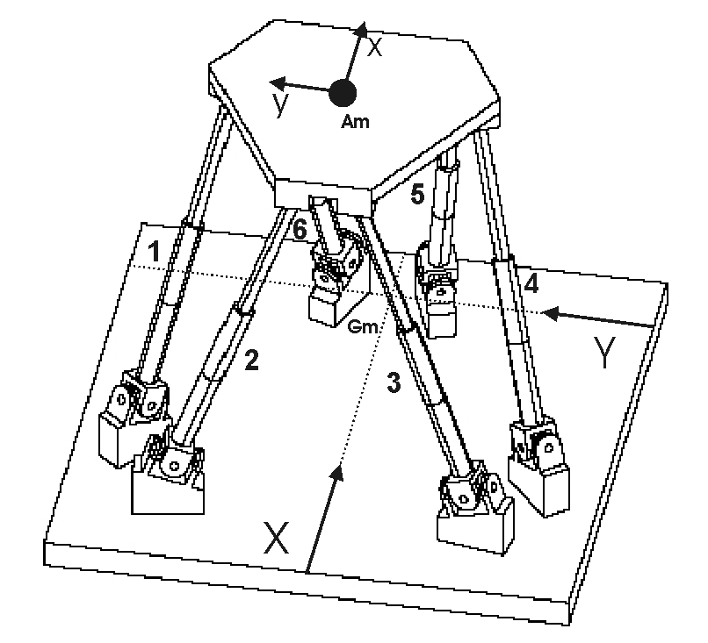
A model’s chosen state variables directly impact the number and complexity of the resulting equations
MapleSim Symbolic Formulation
Model Definition
Example:
Stewart Platform
Coordinate Selection
Equation Generation
Symbolic Simplification
Absolute coordinates (e.g. ADAMS):
78 coords (12 per leg, 6 for the platform),
78 dynamic equations,
+72 constraint equations = 150 equations
Hybrid coordinates (MapleSim):
24 coords( 3 per leg, 6 for the platform)
24 dynamic equations
+ 18 constraints = 42 equations
Code Optimization
Simulation Procedure
Generation
Simulation
Notes:
The multibody technology in MapleSim was developed by a research group at the University of Waterloo and represents many years of research – many more years than MapleSim has been on the market. It’s based on advanced graph theoretic methods that are the evolutionary descendents of earlier techniques like bond graphs.
MapleSim uses graph-theoretic methods to generate the equations of motion for multibody systems. One feature of this approach is that it allows for the systematic separation of terminal equations (equations describing how individual components interact) from topological equations (equations describing how components are connected).
This is significant because by intelligently managing the topological equations, MapleSim's multibody engine can directly control the state variables for a given system. Since the nature and number of the equations of motion are a direct result of the chosen state variables, controlling the state variables gives the multibody engine unprecedented control over equation complexity during the equation formulation process. This delivers computationally efficient sets of symbolic equations that are simplified further by Maple.
This results in faster simulations than approaches that are restricted to only using absolute coordinates as state variables. Benchmarks have shown much higher execution speeds than the most popular existing multibody tools.
For example, ADAMS is a popular tool for multibody

Slide 16
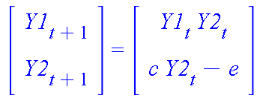
Generated equations are true for all time, using the previous example:
-2 multiplications, 1 addition per step
(versus original 6 and 4, respectively)
Equations can be viewed, analyzed and manipulated in the Maple environment
MapleSim Symbolic Formulation
Model Definition
Coordinate Selection
Equation Generation
Symbolic Simplification
Code Optimization
Simulation Procedure
Generation
Simulation
Notes:
Now, with purely numerical simulation tools, the equations or more correctly the matrices they generate have to be regenerated for each time step. This is numerically expensive. The equations that MapleSim generate are true over all time steps. Additionally, these equations are in a form you can view, manipulate and analyze in Maple

Slide 17
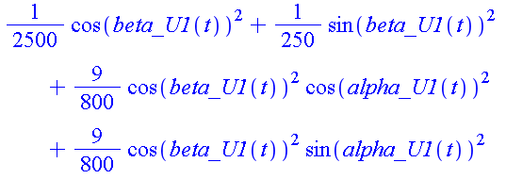

Multiplications by 1’s, 0’s automatically removed (previous slide)
Simple equations directly solved, reducing the number of variables to integrate
Trigonometric simplifications:
MapleSim Symbolic Formulation
Model Definition
Coordinate Selection
Equation Generation
Symbolic Simplification
Code Optimization
Simulation Procedure
Generation
Simulation
Notes:
Once we’ve generated the equations, we also simplify them symbolically. This can be something as simple as resolving multiplications by one or zero, or we can do something that’s rather more complication. We can also solve certain classes of generated equations symbolically to give explicit solutions.
Then there’s the more complicated symbolic techniques we apply. We can make trigonometric substitutions to make equations simpler to solve numerically.
Highly constrained systems often result in what are known as high index differential algebraic equations. We apply our technology to symbolically reduce the index of that DAE system to make it computationally simpler to solve numerically.

Slide 18
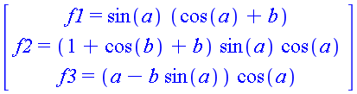
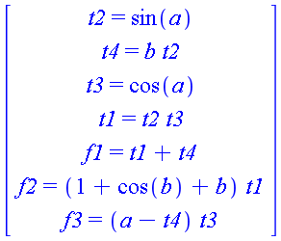
MapleSim Symbolic Formulation
Expressions that are repeated within the equations are identified and isolated so they are only computed once
Model Definition
Coordinate Selection
Equation Generation
Symbolic Simplification
Code Optimization
Simulation Procedure
Generation
Simulation
Notes:
Code Optimization. This is an important feature. Once we’ve simplified the equations, we optimize them for numerical simulation. We do this by identifying common subexpressions inside equations . So in this system we often uses sin(a). Instead of evaluating sin(a) several times, we evaluate it once, and use the numerical result several times.

Slide 19
MapleSim Symbolic Formulation
Model Definition
Using MapleSim’s Addons, optimized procedures can be exported to a variety of targets:
  LabVIEW RT Toolchain
  Simulink RTW Toolchain
Alternatively, these procedures can be generated in Standalone C-code (no Connectivity Toolboxes required)
Coordinate Selection
Equation Generation
Symbolic Simplification
Code Optimization
Simulation Procedure
Generation
Simulation
Notes:
You can export plant models from MapleSim to real-time toolchains. Simulink and Labview. From these tool chains you can run the plant model on real-time hardware, like NI PXI boxes. In fact, that’s something we’ve experience in doing inside Maplesoft

Slide 20

Faster real time simulation
Symbolic multibody model formulation
Model simplification and optimized code generation
More systems become feasible for RT sim
Simulation cycle time = 10ms | SimMechanics (μs) | MapleSim → S-function → Simulink (μs) | Speed advantage
Double Pendulum | 137 | 14 | 9.9x
Four Bar Linkage | 288 | 70 | 4.1x
Stewart Platform | 710 | 74 | 9.6x

Slide 21
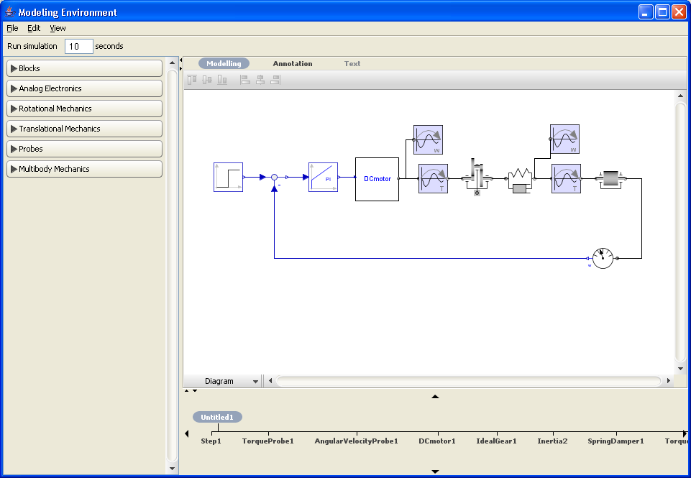
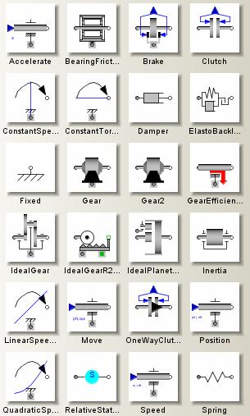
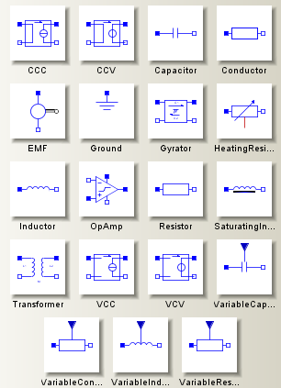
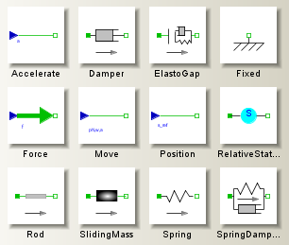
Multi-Domain Modeling

Slide 22
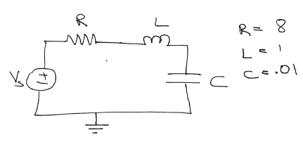
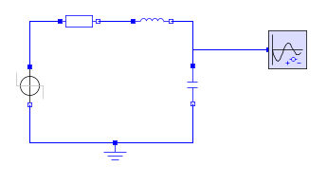
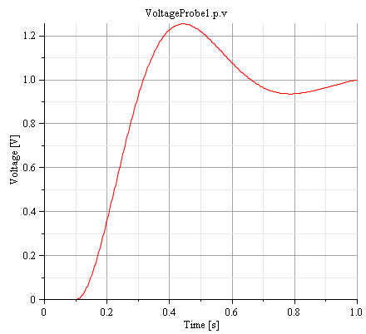
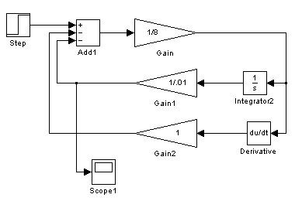
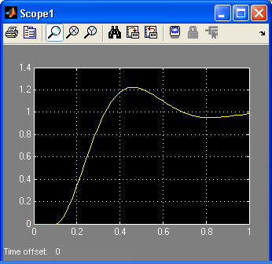
Simple Example
MapleSim Equivalent
Simulink
Equivalent
Advantages
Interactive Graphical Modeling of functional elements which interact with each other (acausal)
Automatically builds the Mathematical Model of System which can be viewed, analyzed and fully documented

Slide 23
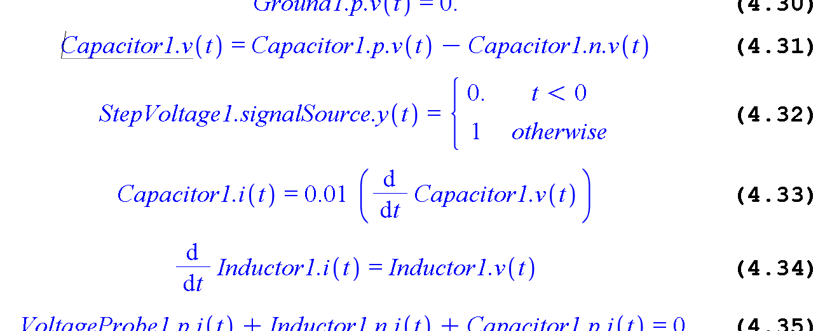
Generated Equations from RLC Example

Slide 24
The Evolution of Multi-Domain Modeling
General purpose
languages
e.g. FORTRAN
Specialized numerical
mathematics
e.g. NAG, MATLAB
State-based
simulation
e.g. Simulink
Acausal modeling
environments
e.g. MapleSim
Problem Analysis
Problem Analysis
Problem Analysis
Problem Analysis
Human effort
Intuition & physics
Intuition & physics
Intuition & physics
Intuition & physics
Model equations
Model equations
Model equations
Model equations
Simulation model
Simulation model
Simulation model
Simulation model
Numerical
algorithms
Numerical
algorithms
Numerical
algorithms
Numerical
algorithms
Computer effort
Execute numerical
algorithms
Execute numerical
algorithms
Execute numerical
algorithms
Execute numerical
algorithms
Numerical experts
Math experts
Modeling experts
Engineers
User
User
Math experts
Modeling experts
Engineers
User
User
Modeling experts
Engineers
User
User
Engineers
Notes:
24

Slide 25
Case studies and demonstrations

